Slide 1


US Car accident analysis
Submitted by Brutus Lo

Slide 2
Introduction Perspectives of an Auto insurance company
Frequency and severity of car accidents are important to know.
What are possible factors affecting severity of a car accident?
Weather patterns
Weather factors
Presence of Point of Interest
This report only focus on weather factors

Slide 3
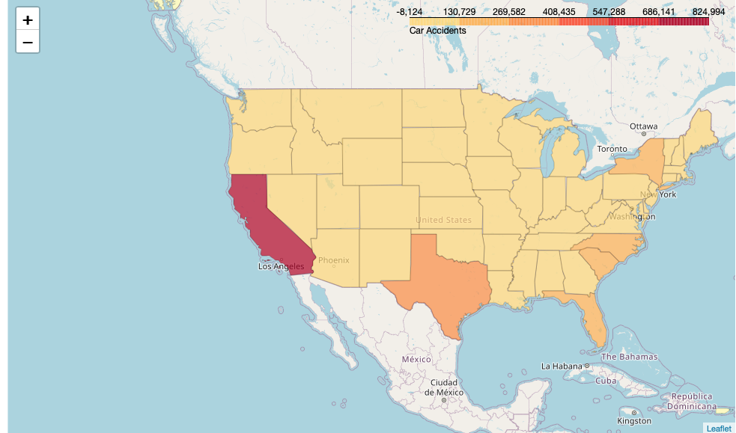
dataset
Dataset covers 49 contiguous states of the USA from Feb 2016 – June 2020
Totaling 3.5 million records
Credits/Acknowledgements:
Moosavi, Sobhan, Mohammad Hossein Samavatian, Srinivasan Parthasarathy, and Rajiv Ramnath. “A Countrywide Traffic Accident Dataset.”, 2019.
Moosavi, Sobhan, Mohammad Hossein Samavatian, Srinivasan Parthasarathy, Radu Teodorescu, and Rajiv Ramnath. "Accident Risk Prediction based on Heterogeneous Sparse Data: New Dataset and Insights." In proceedings of the 27th ACM SIGSPATIAL International Conference on Advances in Geographic Information Systems, ACM, 2019.

Slide 4
Data Cleanup
Original dataset has 49 attributes
Focusing only analyzing weather condition and pattern
Eliminate unneeded data using .drop
Finding missing data then using .replace of nan by the average values

Slide 5
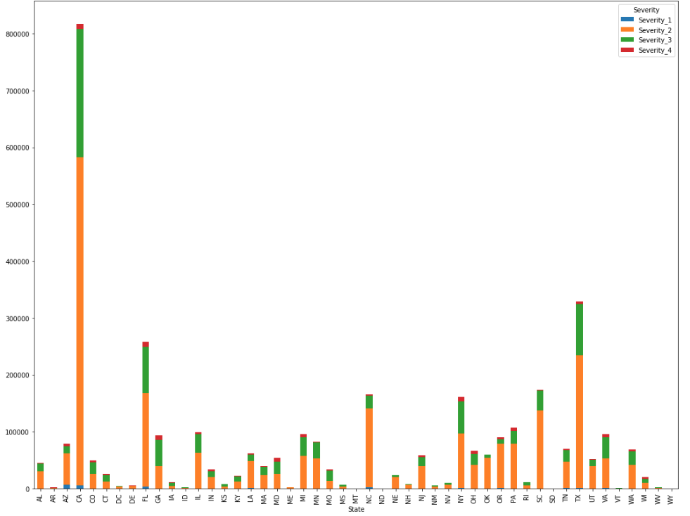
Overview: accident severity by State
California has the highest # of accidents and has more than double the frequency of accidents than the next state, Texas

Slide 6
Accident distribution

Slide 7
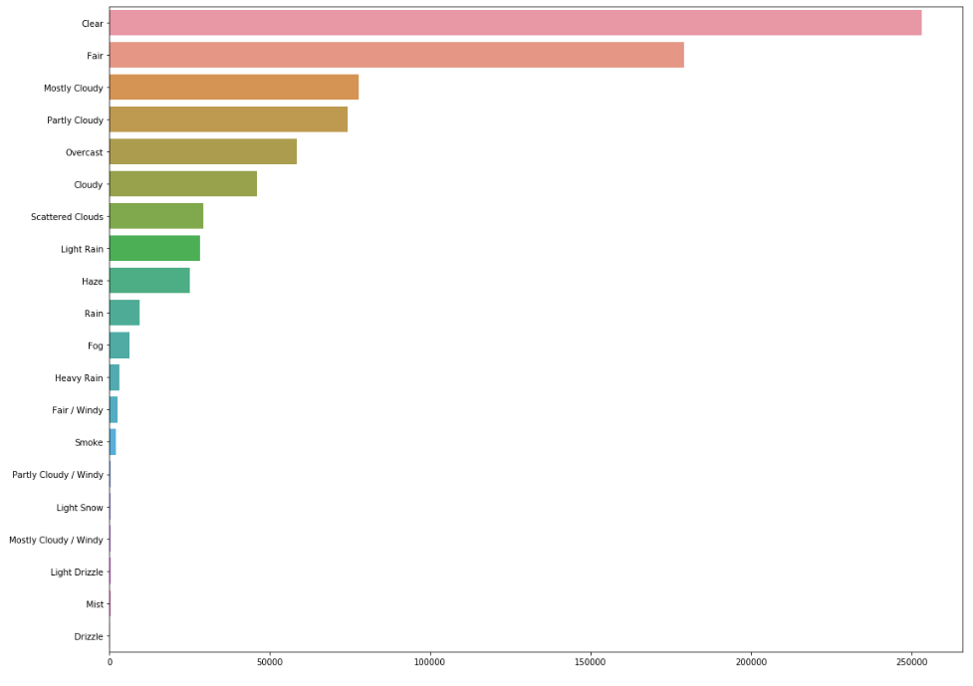
Accident frequency in various Weather conditions: Ca Data Only
Surprisingly, most accidents occurred in clear weather condition.
Very small number of accidents occurred in snowing, foggy or what we would call “Poor” conditions.

Slide 8

Weather factors
Windspeed
Temperature
Wind chill
Humidity
Visibility
Pressure

Slide 9
Linear Regression
WEATHER FACTORS | Pearson Coefficient; p-value
Windspeed | 0.041, 4.731e-305
Temperature | 0.024, 5.989e-104
Wind Chill | -0.108, 0.0
Humidity | 0.030, 4.284e-157
Visibility | -0.005, 4.008e-06
Pressure | 0.095, 0.0

Slide 10
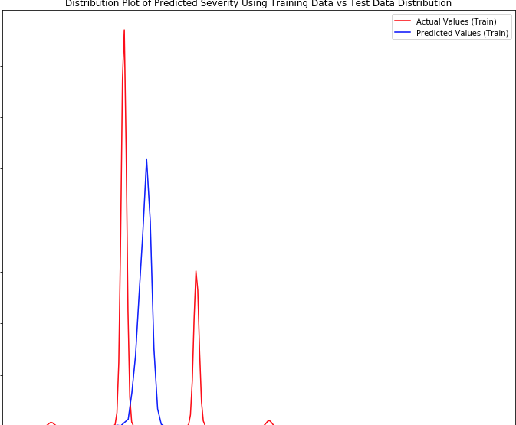
Multiple regression
Test size: 20%
Actual and Predicted values are far off

Slide 11
Ridge Regression & Grid Search
Ridge Regression results:
predicted: [2.15239507 2.47268982 2.34856686 2.23223706] test set : [2 2 3 2]
Best RR Score using various alpha: .030

Slide 12
Conclusions & Further studies
weather factors do not give Good prediction of Severity of a car accident
Further Studies:
Presence of Point of Interests
Time of the day

